Slide 1

ML Test
Insight of Property Data

Slide 2
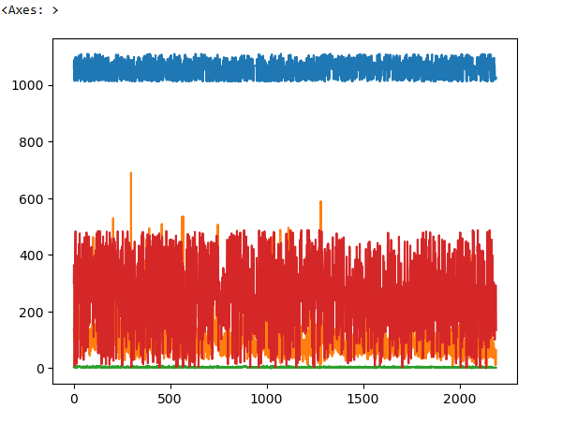
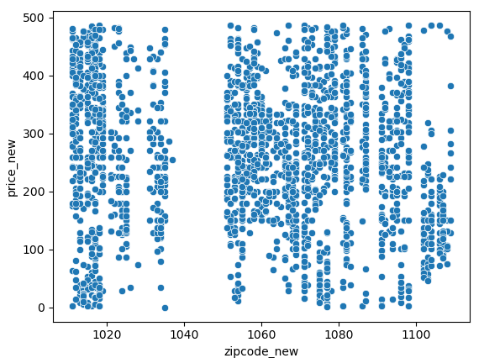
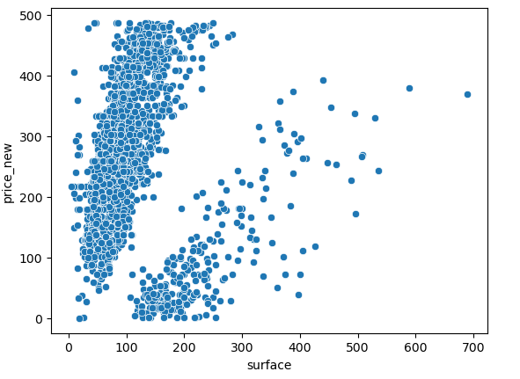
Insight from Property data
The Price of the property increase based on the surface area & number of rooms.
Along with that zip code of that particular area also has impact on it.
Same can be observed from below graph plots.

